Slide 1

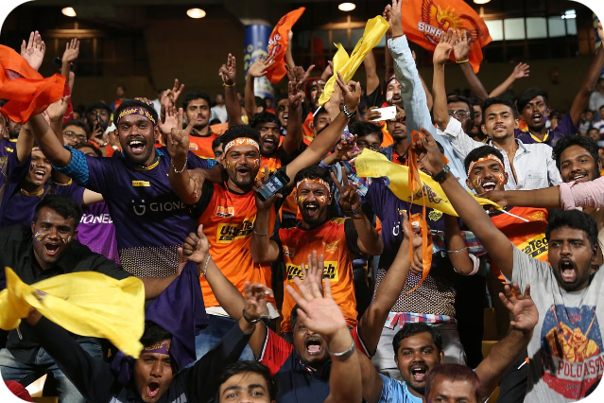

Unlocking IPL Success: A Data-Driven Auction Strategy
This presentation outlines a strategic approach to the IPL auction, leveraging historical data analysis to build a competitive franchise.
by Vivek Kumar

Slide 2

IPL Auction Strategy
Budget: The team would need to allocate a budget for the auction and decide how much money to spend on each player.
Team needs: The team would need to identify the positions and types of players they need to fill out their squad and target those players in the auction.
Player availability: The team would need to assess the availability of players, including their current contracts with other teams and their international commitments.
Player form: The team would need to consider the recent form and performances of the players they are targeting.
Player value: The team would need to consider the market value of the players they are interested in and decide how much they are willing to pay for them.

Slide 3
Building a Balanced Squad: Key Consideration
IMPORTANT POINTS :
We are provided with the IPL data from the first season to the 13th season which was held in 2020. Read and analyze the data properly before loading it into your sql server.
The Key Considerations To Sort Out the Players for IPL Auctions are given in this file

Slide 4



Identifying Undervalued Players: Finding Hidden Gems
Position
Skills
Undervalued Profile
Batsman
High strike rate, ability to play spin
Young player with potential but not yet established.
Bowler
Varied deliveries, economical bowling
Proven performer in domestic leagues but not yet tested in IPL.
All-rounder
Balance of batting and bowling skills
Underestimated player with potential to excel in both roles.

Slide 5

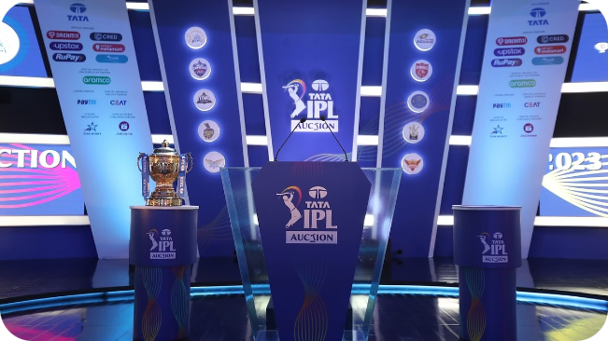
Developing an Auction Plan: Strategic Bidding and Budget Allocation
Target Players
Prioritize key players based on analysis and budget constraints.
Bidding Strategy
Develop a strategy for bidding on target players, considering competition and market value.
Budget Allocation
Allocate funds strategically, balancing high-value players with potential investments.

Slide 6

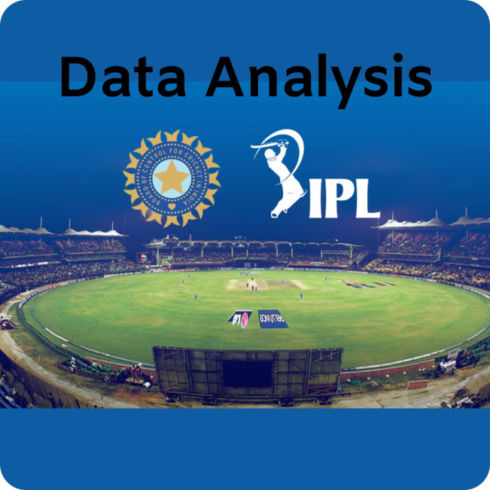



Visualizing Squad Composition: Data-Driven Insights
Batting Order
Visualize the batting lineup based on player strengths.
Bowling Attack
Analyze pace, spin, and variation combinations.
Player Roles
Highlight key players and their roles in different match situations.

Slide 7
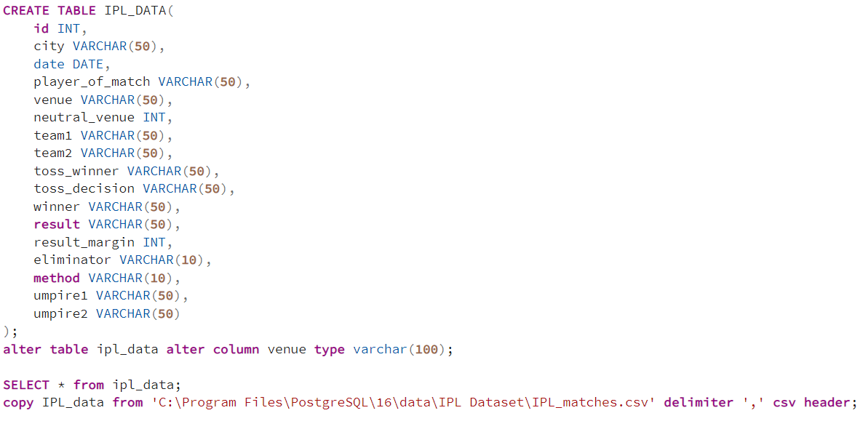
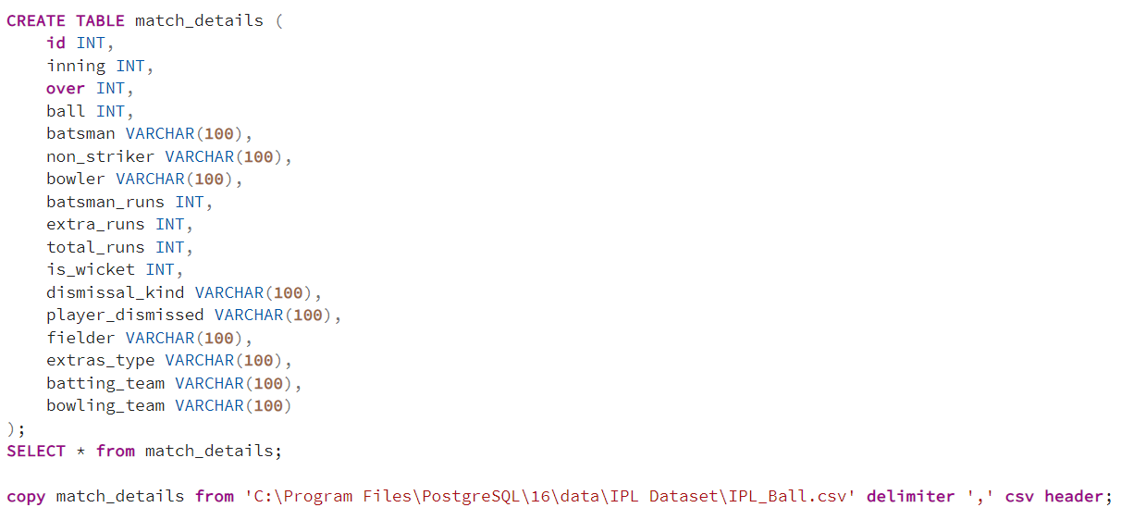
TABLE CREATION OF IPL DATA

Slide 8
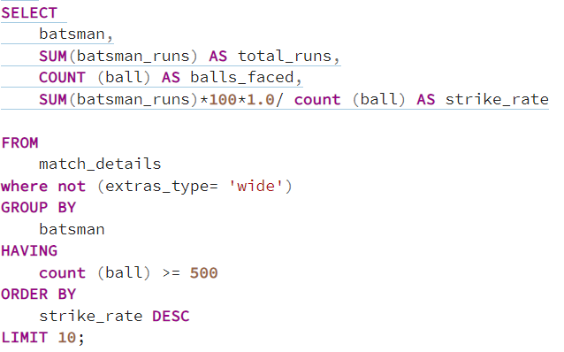
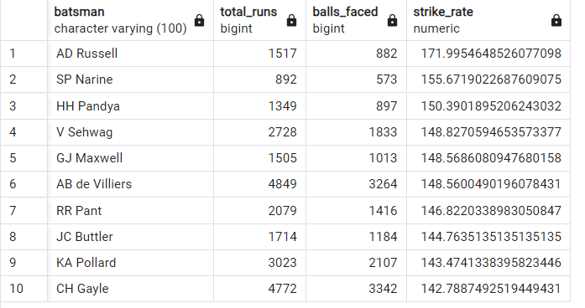
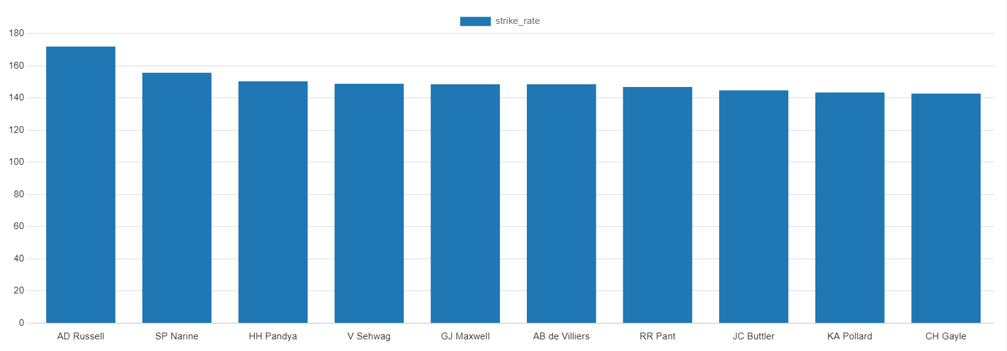
1
Aggressive
batters

Slide 9
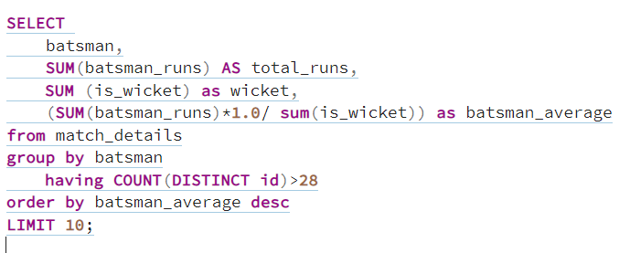
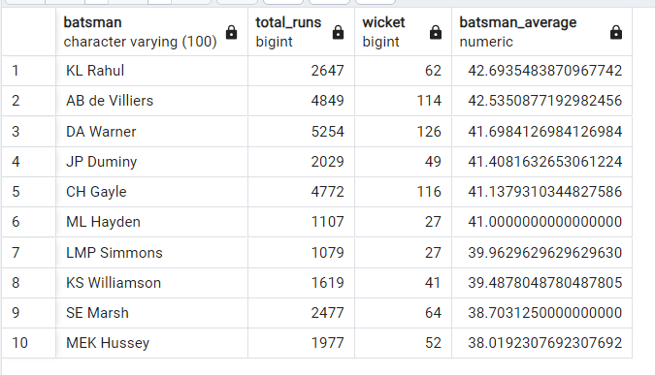
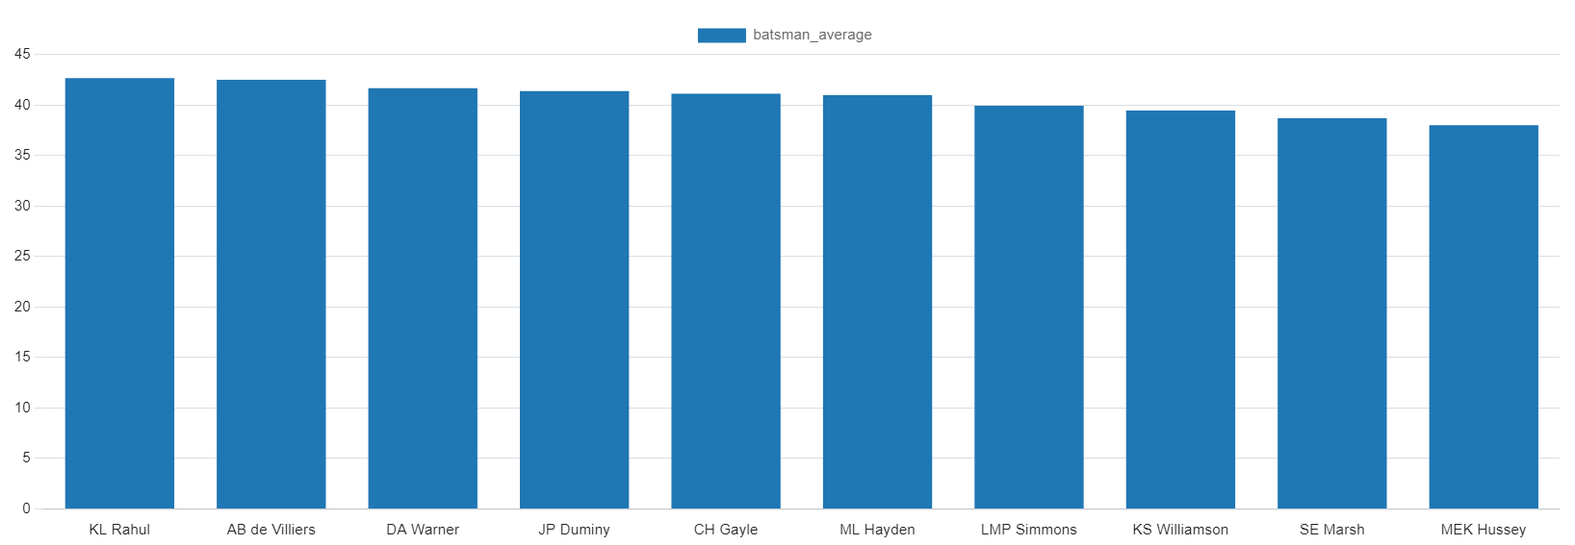
2
ANCHOR
batters

Slide 10
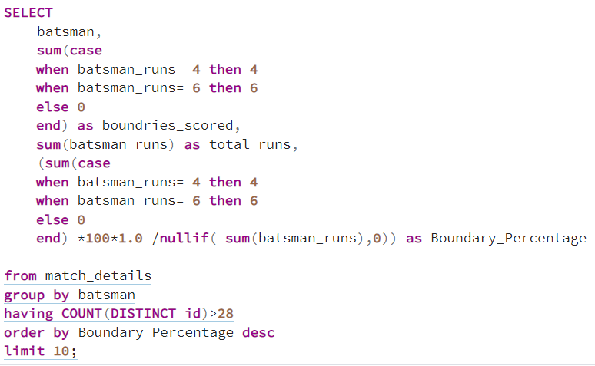
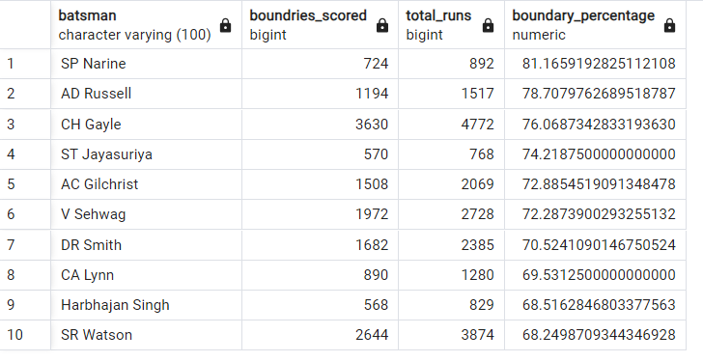
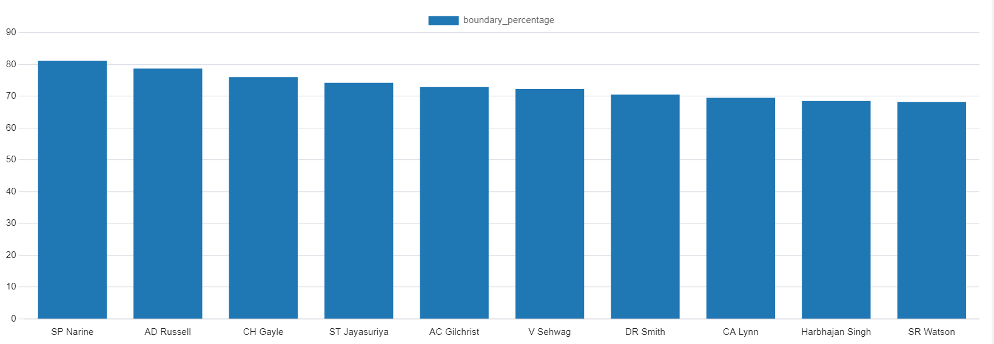
3
HARD HITTING
BATSMAN

Slide 11
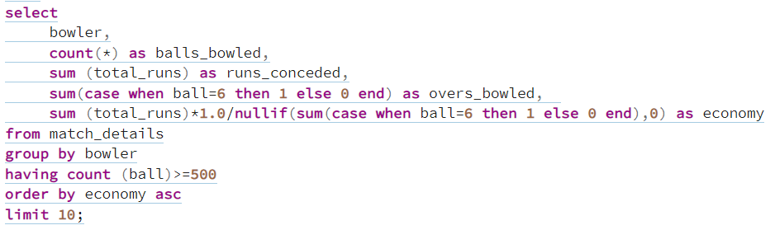
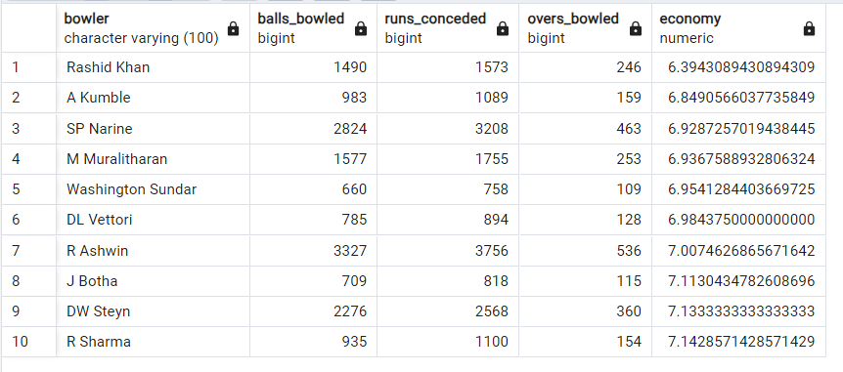
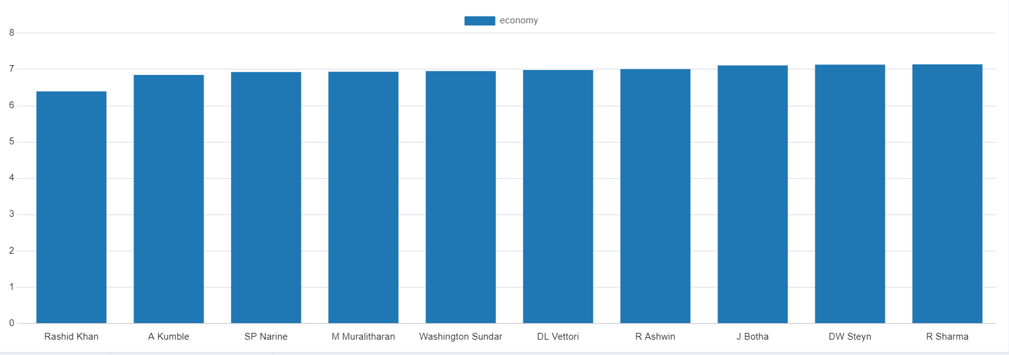
4
ECONOMICAL
BOWLERS

Slide 12
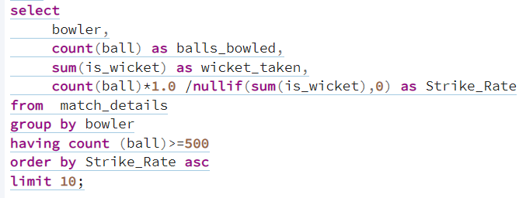
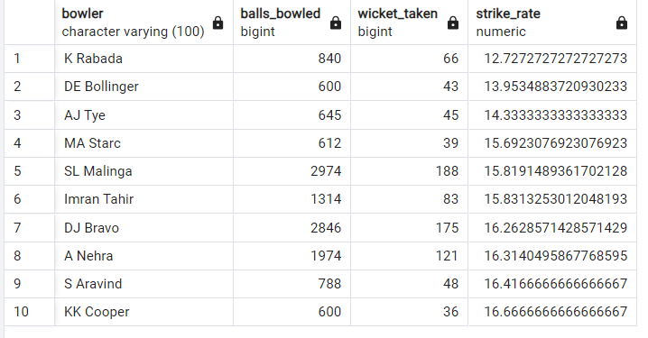
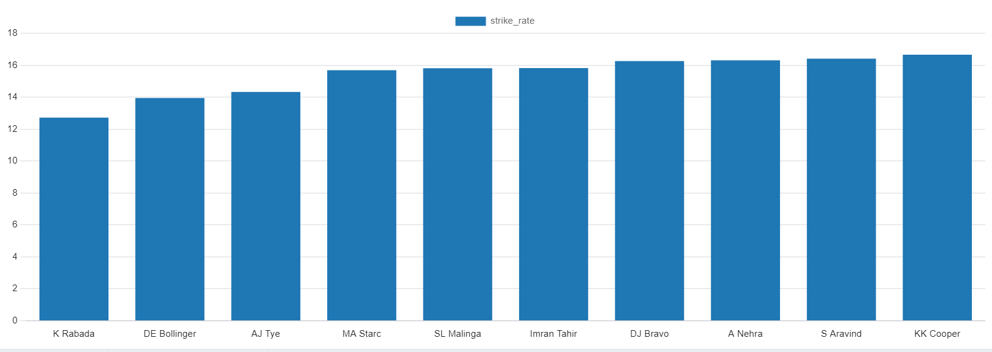
5
WICKET TAKING
BOWLERS

Slide 13
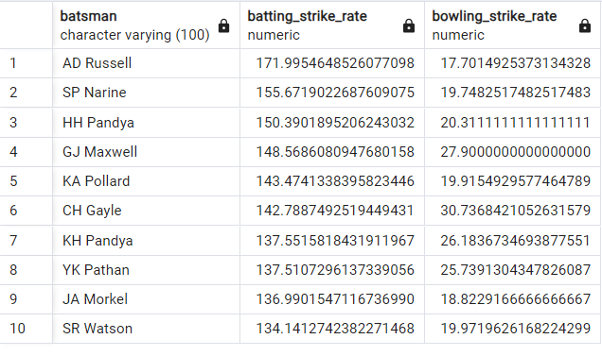
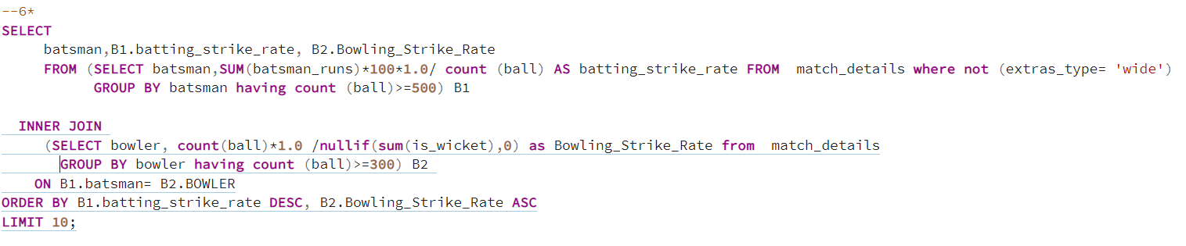
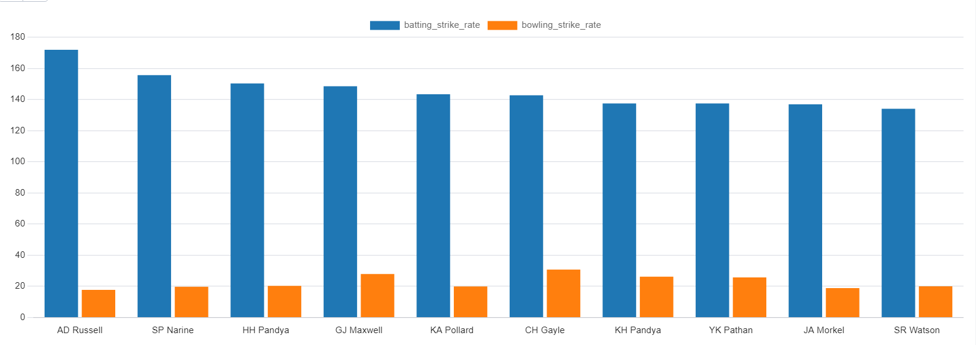
6
ALL-ROUNDERS

Slide 14
6
WICKET-
KEEPERS
1. Total Dismissals (Catches + Stumpings):
Importance: This is the primary metric for a wicketkeeper. The more dismissals
(catches and stumpings) a wicketkeeper has, the better they are likely considered.
2. Batting Average:
Importance: A wicketkeeper who can contribute significantly with the bat is often preferred,
especially in modern cricket.
3. Strike Rate:
Importance: In shorter formats of the game (T20, ODIs), a wicketkeeper’s ability to
score quickly is valuable.
4. Matches Played (Experience):
Importance: Experience is crucial, as more experienced wicketkeepers are generally
more reliable and consistent.
A greater number of matches played indicates experience and reliability.

Slide 15



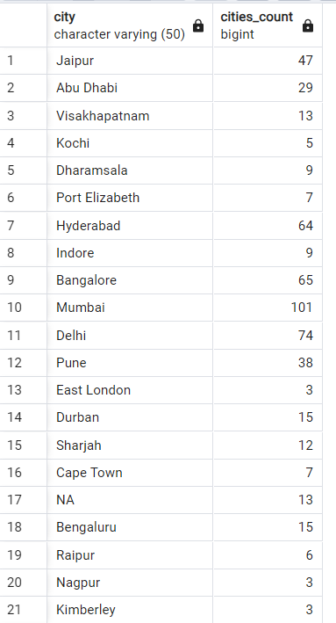
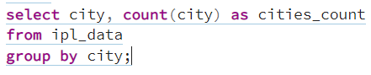
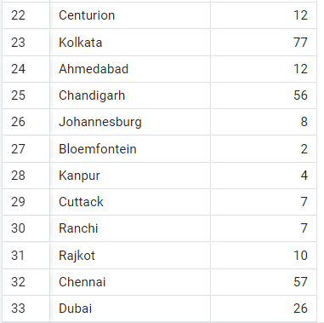


Count of cities that have hosted an IPL match.

Slide 16
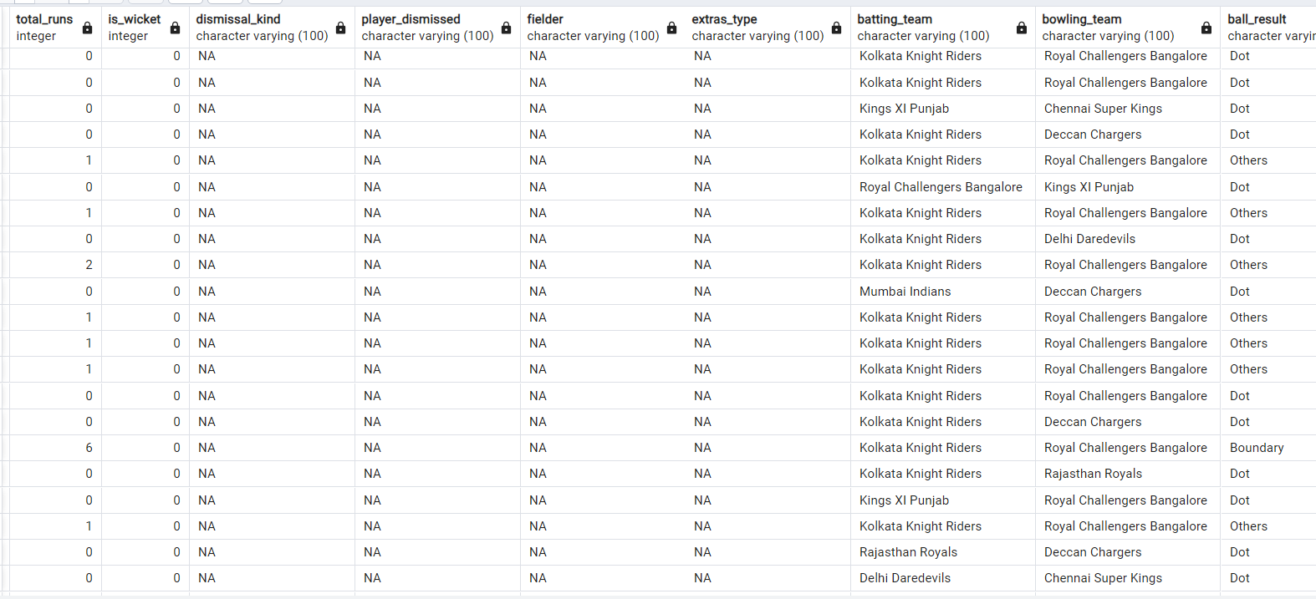
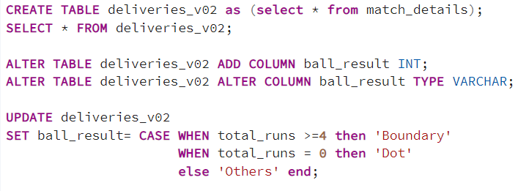
Containing values boundary, dot or other.

Slide 17
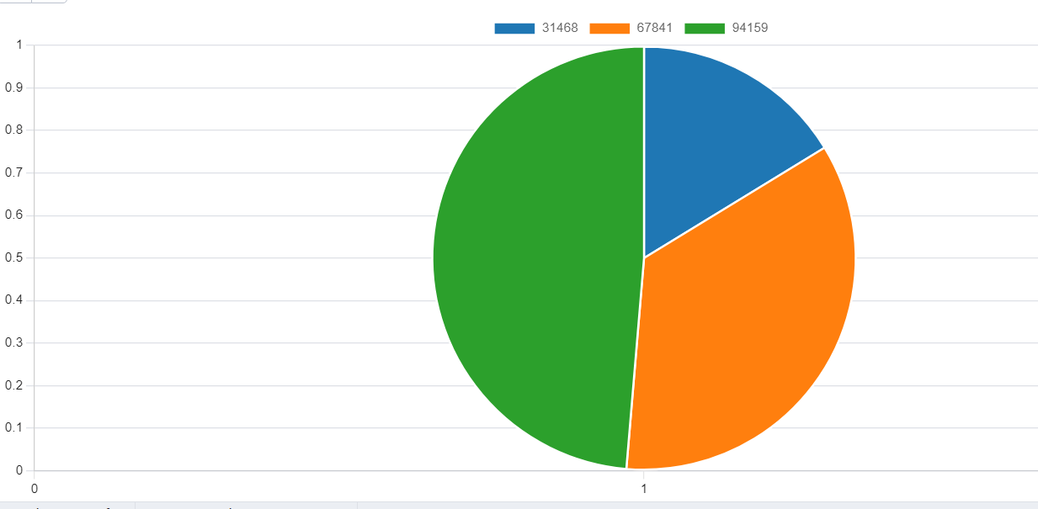
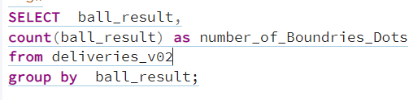
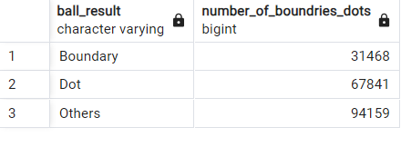
Total number of boundaries and dot balls.

Slide 18
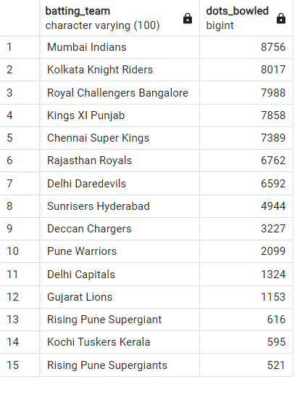
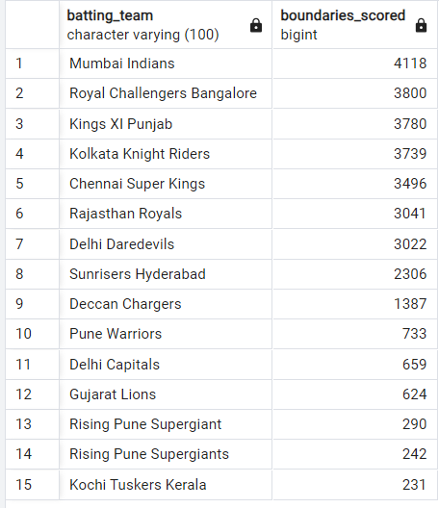
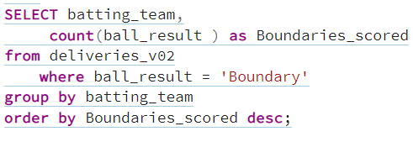
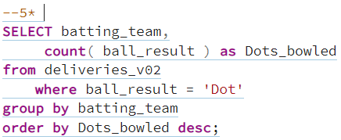
Total number of boundaries scored by each team.
Total number of dot balls bowled by each team.

Slide 19
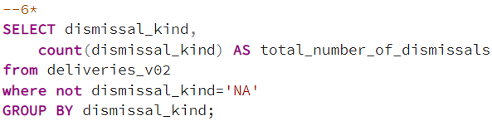
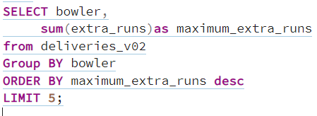
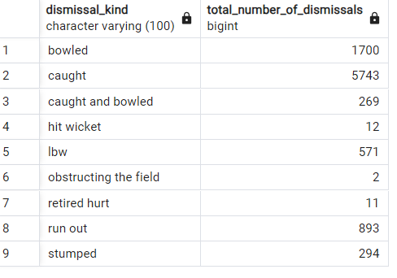
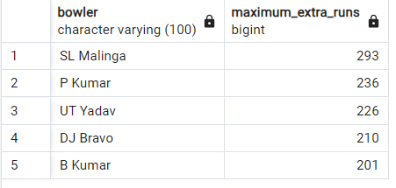
Total number of dismissals by dismissal kinds.
Top 5 bowlers who conceded maximum extra runs.

Slide 20
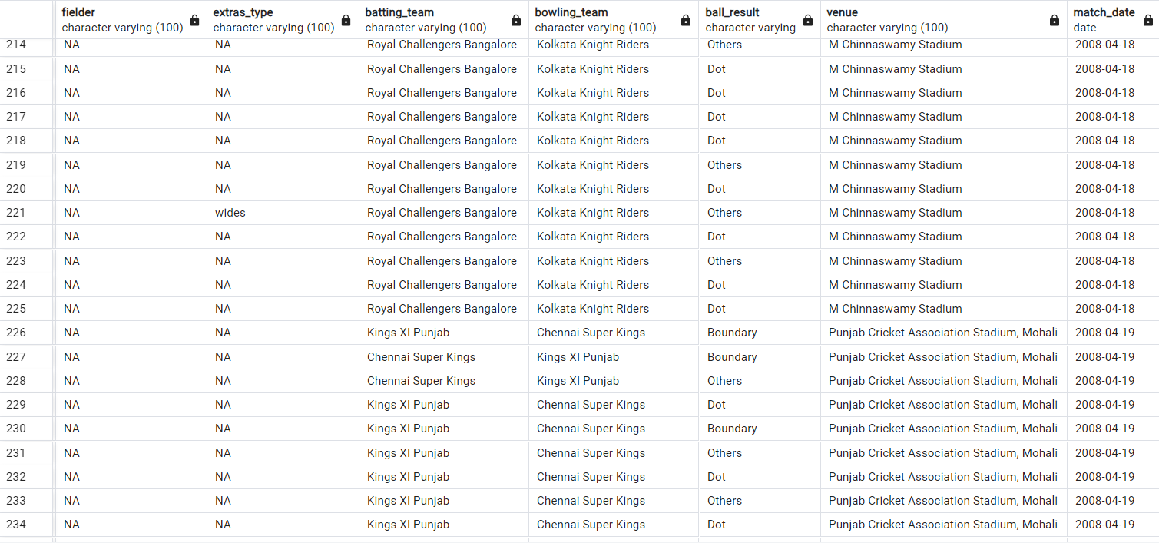
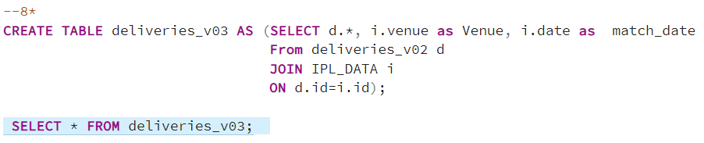
Create a table named deliveries_v03 with all the columns of deliveries_v02 table and two additional column (named venue and match_date) of venue and date from table matches.

Slide 21
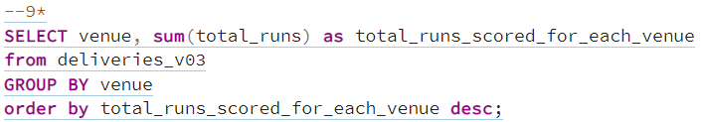
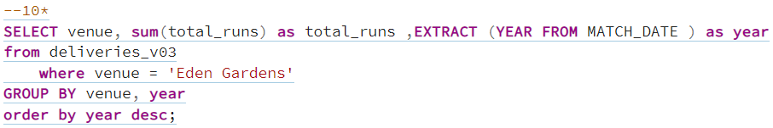
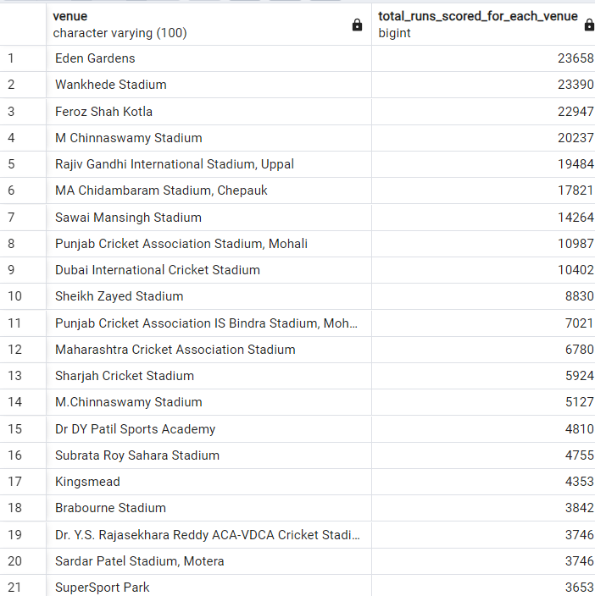
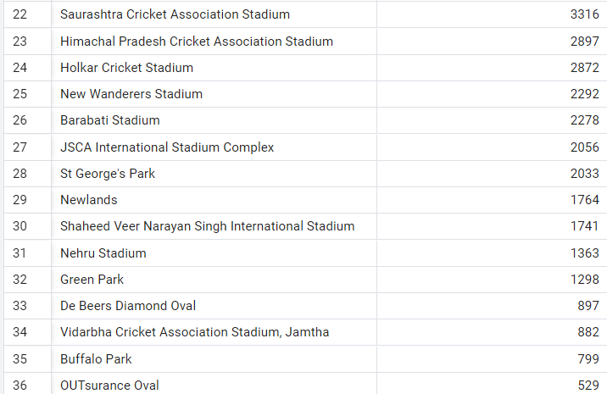
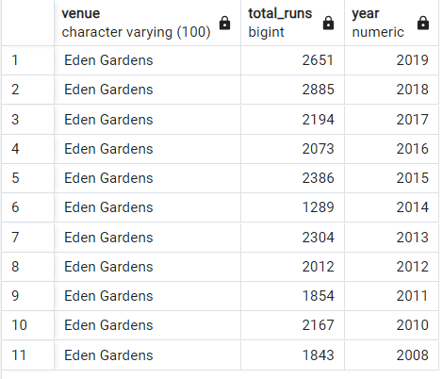
Total runs scored for each venue.
Year-wise total runs scored at Eden Gardens.

Slide 22
THANK YOU

